Slide 1
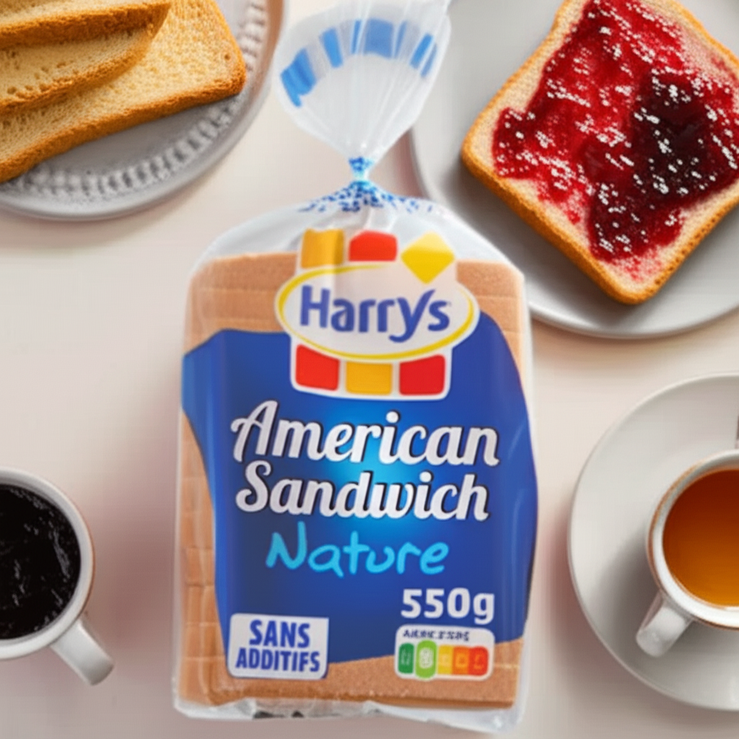
Market Performance Analysis: Harry's Bread France
Business Insights & Dashboard Project
Prepared by: Shubham Rawat
Date: September 2025

Slide 2
Agenda
💡 Background & Objective – Why we did this project
📊 Data Sources – Sales, Costing, Marketing datasets
⚙️ Methodology – Cleaning, KPIs, Dashboard creation
🔑 Key KPIs – Revenue, ROI, Units Sold, Market Share
📈 Dashboard Insights – Visuals & observations
📝 Recommendations – Action plan for Harrys

Slide 3
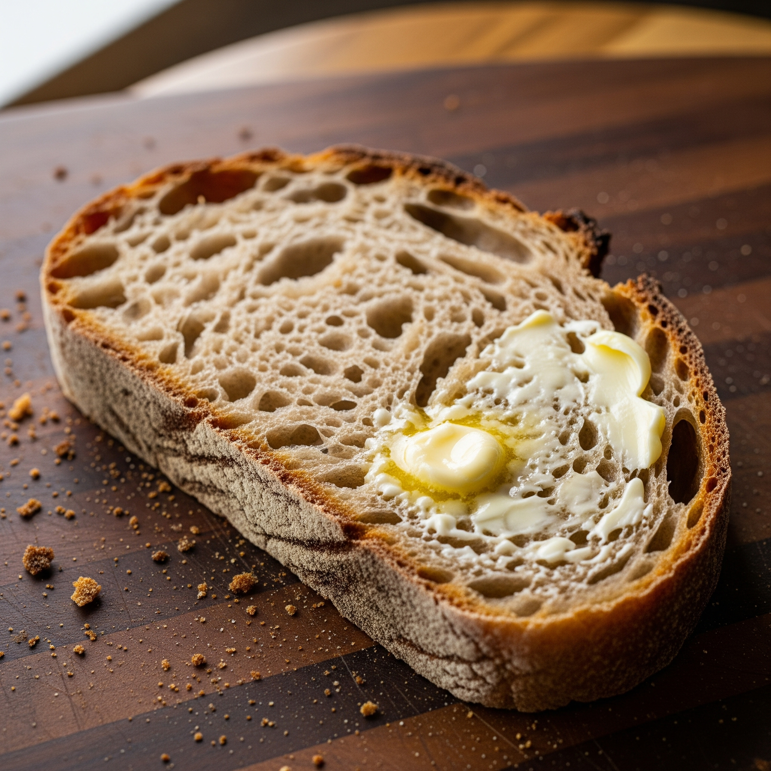
Background & Objective
Harry's operates within the French bakery market, facing significant competition from Jacquet and La Boulangère. A comprehensive analysis of sales, costs, and marketing impact is essential. The objective is to quantify performance, return on investment (ROI), and market share, thereby providing data-driven insights to inform strategic decision-making.

Slide 4
Data Sources
📁 Sales Data: Units Sold, Revenue (Monthly, Regional, Product-wise).
📁 Costing Data: Production and operational costs at the factory level.
📁 Marketing Data: Channel expenditure, competitor sales (Jacquet, La Boulangère).
Data Sources: Harry's internal systems and competitor reports.
Data Preparation: All datasets were cleaned and standardized for analysis.

Slide 5
Methodology
✨ Data Cleansing (Duplicates eliminated, missing values addressed, formats standardized)
📊 Data Processing (Structured datasets developed for Sales, Costing, and Marketing)
📊 KPI Computations (Revenue, ROI, Units Sold, Market Share calculated)
🖥️ Data Visualization (Dashboards constructed utilizing Power BI)
📈 Reporting (Charts, actionable insights, and a comprehensive final project report generated)

Slide 6
Key KPIs
💰 Total Revenue (€) - Overall revenue generated
📦 Units Sold - Total bread units sold
📈 ROI - Return on investment from marketing.
📊 Average Revenue per Unit (€) - Efficiency per unit sold
⚖️ Market Share (%) - Harrys vs Jacquet vs La Boulangère.

Slide 7
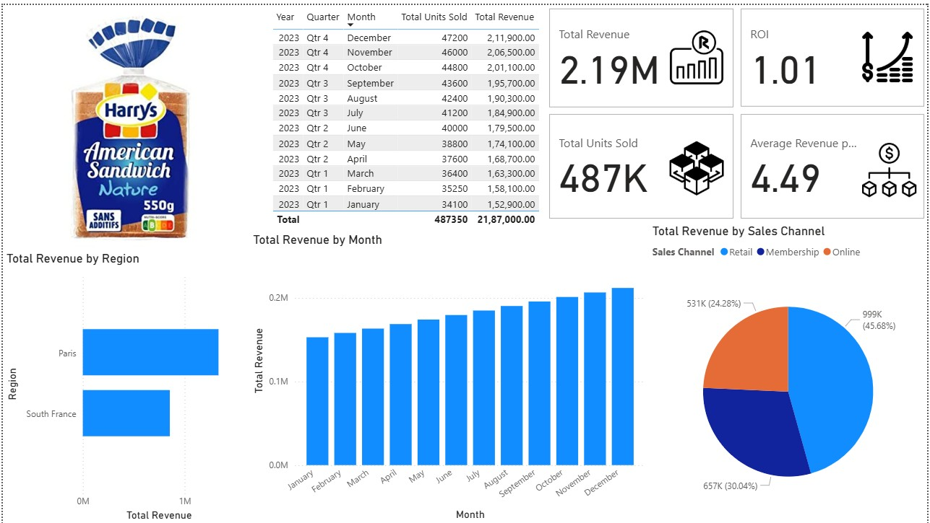
Dashboard Insights
Revenue Trend: Steady growth across months. 📈
Regional Sales: Paris is the top-performing region. 🗺️
Channel Mix: Retail contributes the largest share, Membership is growing.
Cost Structure: Factory A incurs higher costs than others. 🏭
Marketing ROI: Online channel delivers the best returns. 💡
Market Share: Harrys leads but faces competition from Jacquet.

Slide 8
Tools Used
Content: -
🐍 Python: Utilized for data cleaning, preprocessing, and key performance indicator (KPI) analysis, leveraging libraries such as Pandas and Matplotlib.
📊 Power BI: Employed for developing DAX measures and interactive dashboards.
🐙 GitHub: Served as the project repository for version control and portfolio management.
📈 Excel: Used for initial data storage and preliminary data exploration. Note:

Slide 9
Thank You
Content:
Conclude with a concise statement such as "Questions?" or "Open for Discussion."
Specify the team or project name; for instance, "Harry's Market & Competitor Analysis Project."
Include individual or group member names as required.
Visual Suggestions:
Feature prominent "Thank You" text centrally.
Incorporate the Harry's logo (if available) or a relevant icon like a bread or market graphic 🍞📊.
Maintain a clean background and minimal text.

